Slide 1

IMAGE COMPRESSION USING DCT
Presented by
Tushar Raj (20104108019)
Anchal Rani (20104108013)
Anuj Kumar (20104108056)
Nadeem Kausar (21104108907)
Under the Guidance of
Rohit Kumar
Assistant Professor
Department of Electronics and Communication Engineering
Bhagalpur College of Engineering

Slide 2
Table of Content
01. About Image
05. DCT-Properties
02. Image Compression
02. Image Compression
02. Image Compression
06. DCT- Types
03. Literature Review
07. Tools used - MATLAB
04. Proposed Algorithm - DCT
08. Code and Implementation

Slide 3

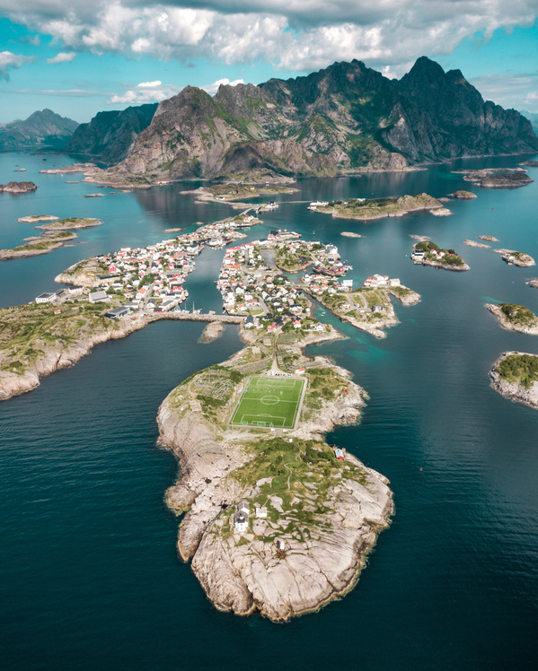
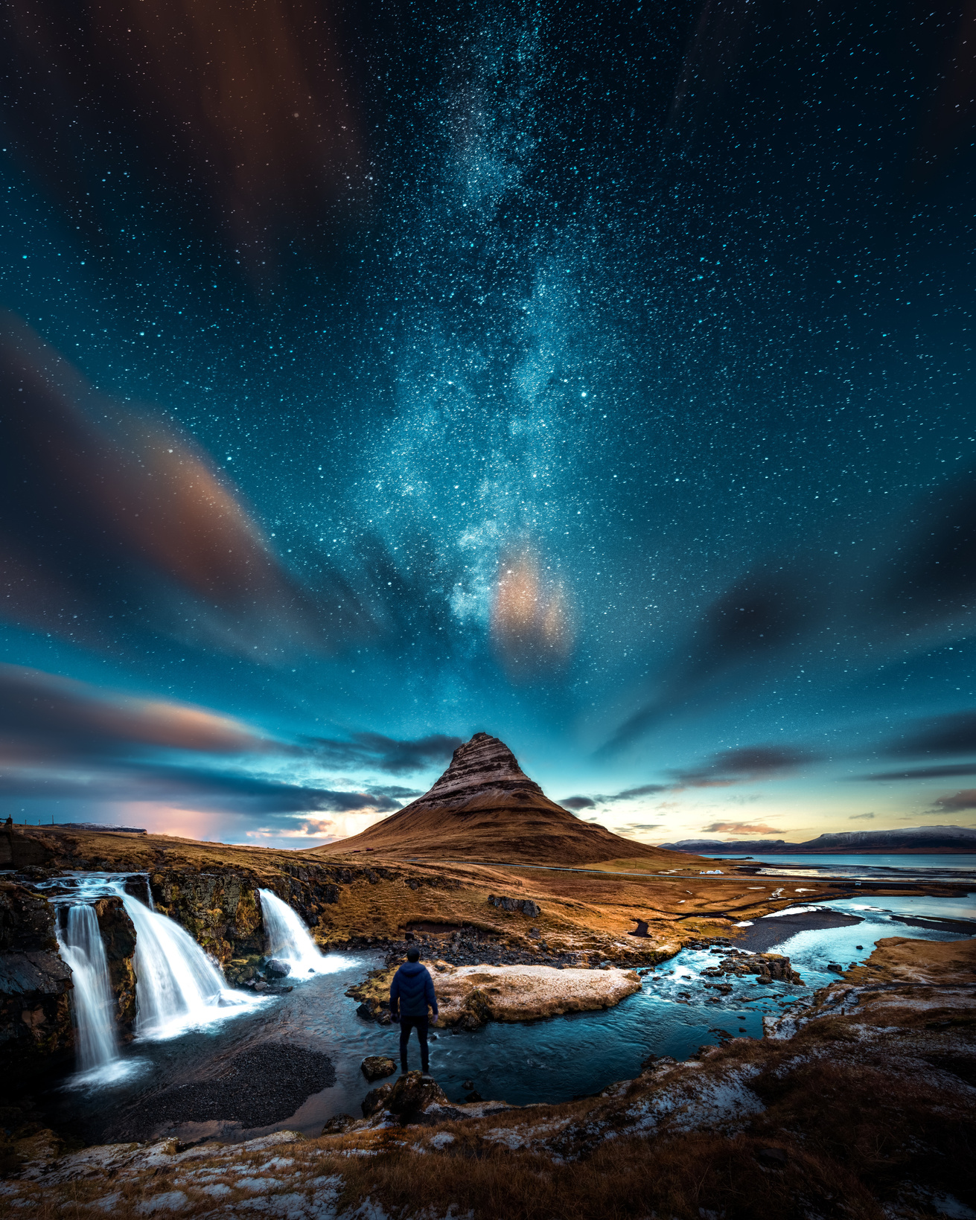

WHAT IS AN IMAGE ?
Exposure
An image is a spatial representation of a two-dimensional or three- dimensional scene.
An image is a visual representation or likeness of an object, scene, person, or concept, typically produced by photography, painting, drawing, or other artistic methods.
Viewfinder

Slide 4



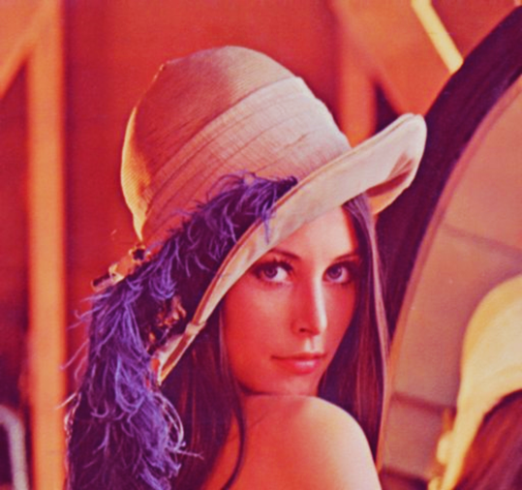

IMAGE GENERATION
Place a regular 2D grid over an image and read the color value at the intersections of the grid => set of data points for that image !!

Slide 5
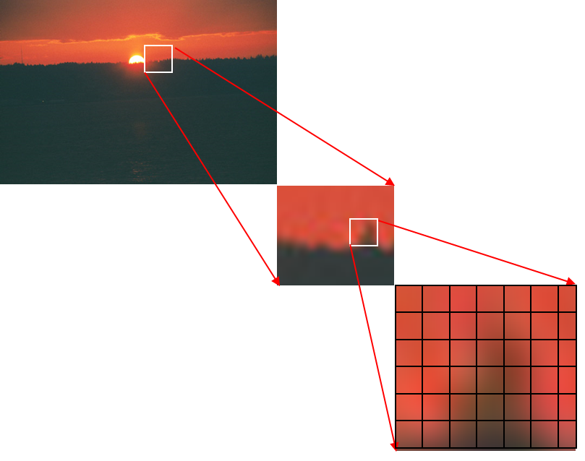
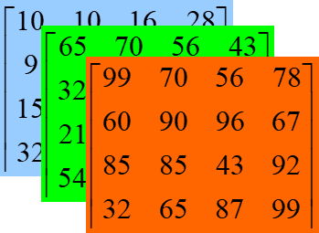
DIGITAL IMAGE
A Digital image is a representation of visual information in a digital format, consisting of a grid of picture elements (pixels), each containing color or intensity values.
Each pixel in an image is represented by three values: the intensity of red, green, and blue channels. These values typically range from 0 to 255, where 0 represents no intensity (absence of the color) and 255 represents maximum intensity (full presence of the color).

Slide 6


Image Attributes
Ready to start?

Slide 7




Intensity refers to the amount of light or brightness in an image. Higher intensity values represent brighter areas, while lower intensity values represent darker areas.
INTENSITY
Brightness is a subjective perception of how light or dark an image appears. It can be adjusted to control the overall luminance of an image. Increasing brightness makes the image appear lighter, while decreasing it makes the image appear darker.
BRIGHTNESS
Contrast measures the difference in brightness between different parts of an image. High contrast images have a wide range of brightness values, with distinct differences between light and dark areas. Low contrast images have a more narrow range of brightness values, resulting in a flatter appearance.
CONTRAST

Slide 8
HUE
Hue refers to the dominant color in an image. It's often represented as a position on a color wheel, where each hue corresponds to a specific angle around the wheel. For example, red might be at 0 degrees, green at 120 degrees, and blue at 240 degrees.
Saturation, also known as chroma or colorfulness, refers to the intensity or purity of a color. A highly saturated color appears vivid and intense, while a desaturated color appears more muted or grayish.
SATURATION
Aperture is like the eye of a camera. It's the hole in the lens that lets light in. Just like your eyes adjust in bright or dark places, the aperture can open wide or close down to control how much light gets into the camera. This affects how bright or dim your photo looks, and also how much of it is sharp or blurry.
APERTURE

Slide 9

INTRODUCTION TO IMAGE COMPRESSION
Image compression is a method used to reduce the size of digital images while maintaining an acceptable level of quality for storage or transmission purposes.

Slide 10

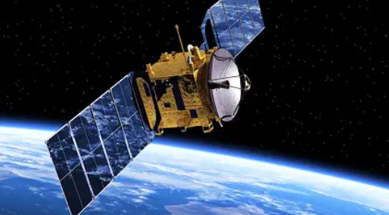
APPLICATIONS OF IMAGE COMPRESSION
Digital Photography: Reduces storage space for high-resolution images on devices.
Video Conferencing: Minimizes bandwidth requirements
for smooth streaming
Medical Imaging: Efficient storage and transmission of medical
images for diagnosis.
Satellite Imaging: Facilitates quick transmission
of large data volumes captured by satellites.

Slide 11
Literature Review of Image Compression
Author | Compression Technique | Compression Method | Description
Clairaut, Lagrange, and Gauss | Lossless | DFT | Transforms spatial information into frequency domain,enabling analysis and manipulation based on frequency components
G. Sadashivappa, and K. V. S. AnandaBabu | Lossy | Sub-band coding | Explore diverse wavelet functions, analyze properties, implement SPIHT compression in MATLAB.
Somasundaram and Vimala | lossy | block truncation coding | EBTC reduces bit rate leveraging inter-pixel redundancy in compression.
Aditya Kumar and Pardeep Singh | lossy | block truncation coding | The improved algorithm deals with the grayscale image to reduce the

Slide 12
IMAGE COMPRESSION TECHNIQUES
There are two types of image compression:
a. Lossless compression: In lossless compression, we make the photo smaller without losing any details. When we open the compressed photo, it looks exactly like the original one.
Examples include Run-Length Encoding (RLE) and Huffman Coding.
b. Lossy compression: In lossy compression, the compressed picture looks similar to the original but with some loss of detail.
Examples include Discrete Cosine Transform (DCT), used in JPEG compression, and Wavelet Transform, used in JPEG2000 compression.

Slide 13
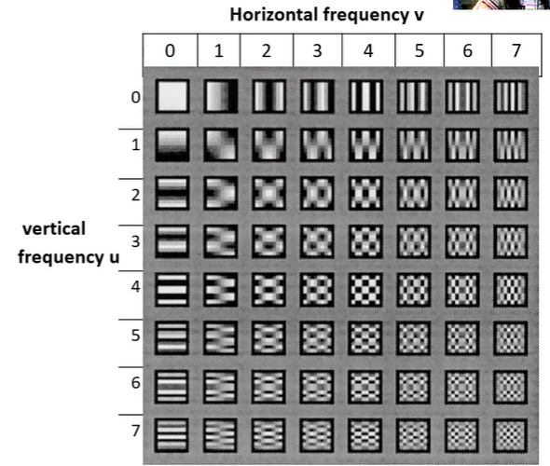

PROPOSED ALGORITHM - DISCRETE COSINE TRANSFORM (DCT)
Discrete Cosine Transform (DCT) is a technique used in image compression to reduce the amount of data needed to represent an image.
It works by converting the spatial domain information of an image into the frequency domain.
DCT breaks the image into small blocks (often 8x8 pixels) and transforms these blocks into a set of coefficients that represent the image's content.

Slide 14

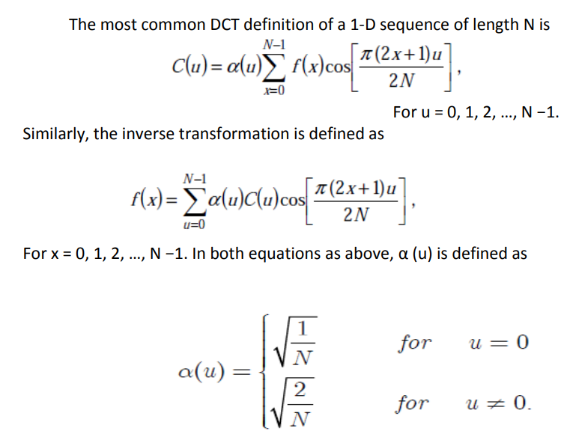
1) THE ONE- DIMENSIONAL DCT:

Slide 15
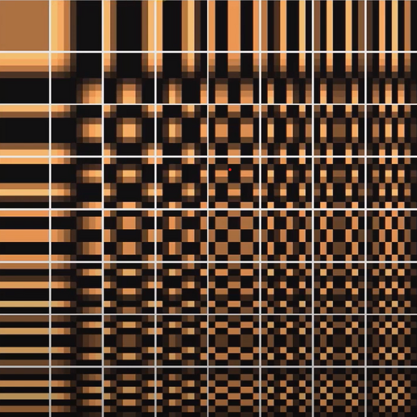
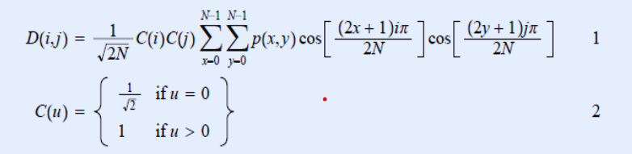
2) THE TWO-DIMENSIONAL DCT:
.The 2-D Discrete Cosine Transform is just a one dimensional DCT applied twice,
once in the x direction, and again in the y direction.
The DCT equation (Eq.1) computes the i, jth entry of the DCT of an image.

Slide 16


PROPERTIES OF DCT
a) Decorrelation: Image transformation, like DCT, removes similarities between nearby pixels, making it easier to compress the image without losing important details.
b) Energy Compaction: A good transformation scheme packs the data into fewer coefficients, so we can throw away the less important ones without making the picture look bad. DCT is great at this, especially for images with a lot of similarities between pixels.
c) Symmetry: Row and column operations in the equation are the same, called symmetric transformation. This allows precomputing the transformation matrix for efficient computation.
D = TMT’

Slide 17


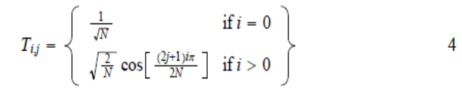

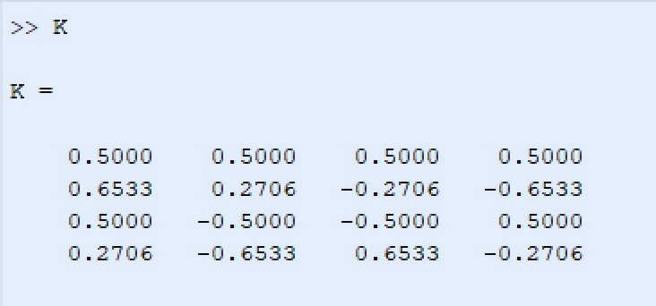
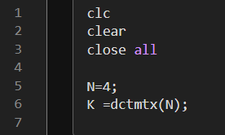



THE DCT MATRIX
To get the matrix form of Equation (1), we will use the
following equation,
For an 4x4 block it results in this matrix:

Slide 18



TOOLS USED - MATLAB
A High level programming Language.
Faster than traditional computing Language
Used in Algorithm Development and Data Analysis
An interactive technical computing environment

Slide 19
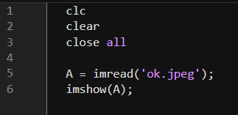
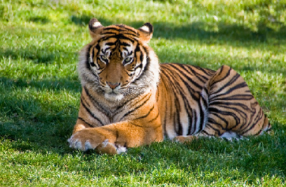
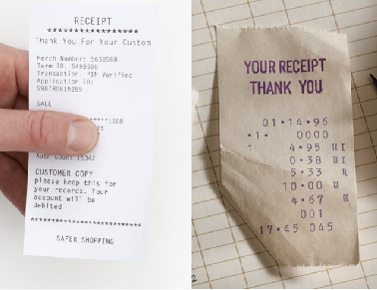
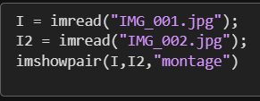
Functions for MATLAB Images
imread(): reads or loads the image which we want to process
imshow(): displays the image that we have loaded
imshowpair(): Utility function for comparing two images

Slide 20
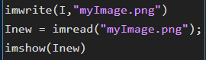
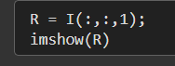
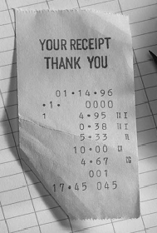
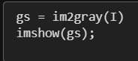
Functions for MATLAB Images
imwrite() :saves a MATLAB image to an image file/folder.
RGB Extraction :Extracting the color requires placing a value in third dimension
im2gray(): convert an image to grayscale

Slide 21
Image and Video formats
JPEG (or JPG) - Joint Photographic Experts Group
HEIF - High Efficiency Image File Format
WebP - Web Picture Format
H.265 (HEVC) - High Efficiency Video Coding
WebM - Web Media File

Slide 22


Critical Reception
Fur​ther Scope in Image Compression
Emergence of High-Resolution Imaging
Mobile and IoT Devices
Virtual and Augmented Reality (VR/AR)
Satellite Imaging
Digital Photography
Remote Sensing

Slide 23


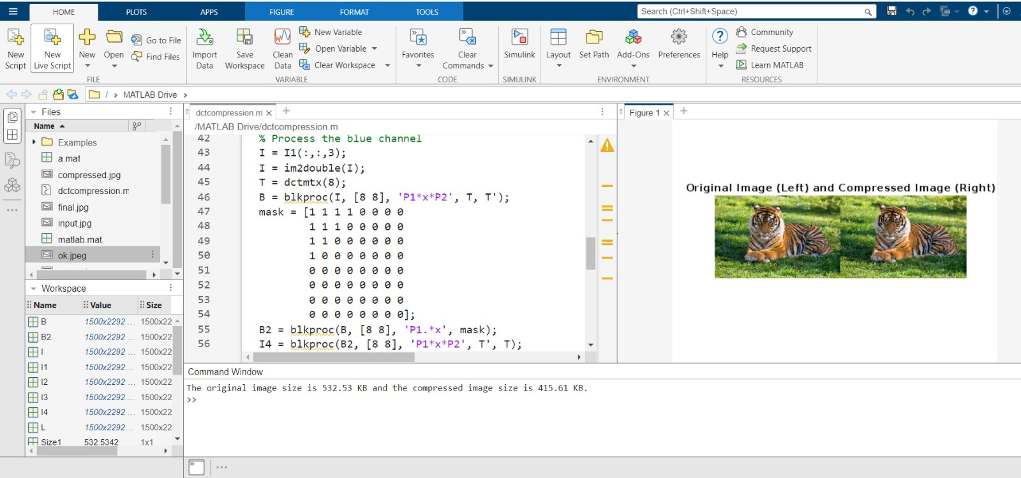

IMPLEMENTATION
Here’s the MATLAB Code and Output Screen

Slide 24
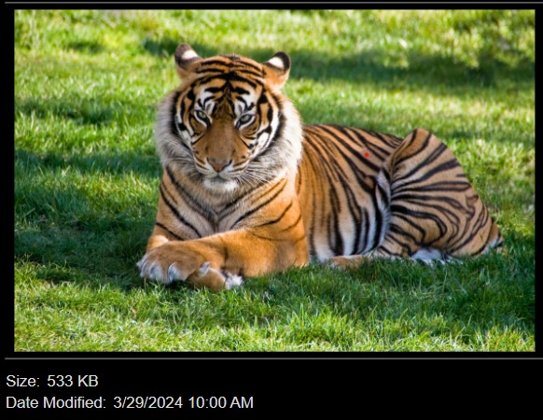
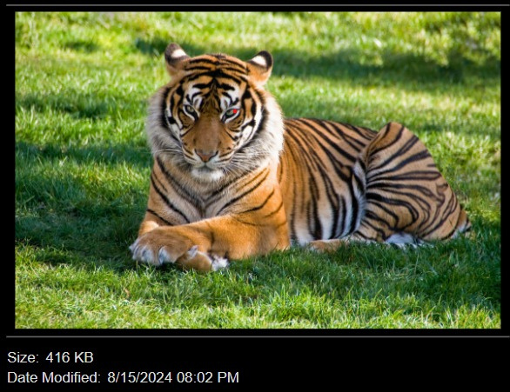
Notice that the size of obtained image is smaller than that of original image.

Slide 25








THANK YOU

